Slide 1
SonarQube Plugin Report
Mario, Kathryn, Andrew, Neil

Slide 2
Approach
Issues that needed addressing
Coming two weeks late to the project
Losing a member of our team
Cloud Programming and SonarQube team background
Familiarizing the team with SonarQube and Cloud Platforms
Difficulty with SonarQube Plugin Guide
Issues arose from SonarQube Plugin Documentation

Slide 3
Accomplishments
Establish a skeleton plugin
Research a series a rules
12 factors of Cloud Computing
Implement the rules
Each rule must is approached differently
Write a proper Documentation for Sonarqube Plugin
Make recommendations for next steps to take
Json Scanner done through a JavaScript Plugin
XML Scanner done through a Xpath Plugin

Slide 4
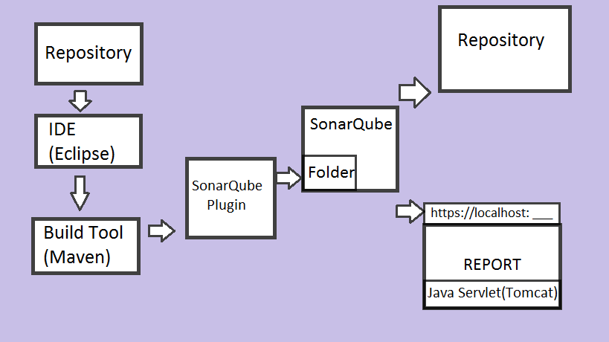
Setup

Slide 5
Demo Explanation
A Rule in a SonarQube Project Consists of 5 files and 1 shared file
<RuleName>Rule.Java
What nodes to search for and what to look for in those nodes
<RuleName>Test.Java
Runs the first file against the third file and its test cases
<RuleName>Test.Java
Test cases included here
<RuleName>.Html
Information about rule in HTML format
<RuleName>.json
Information about the rule that is given to the scanner
Ruleslist.java (Shared File)
List of Rules

